Slide 1
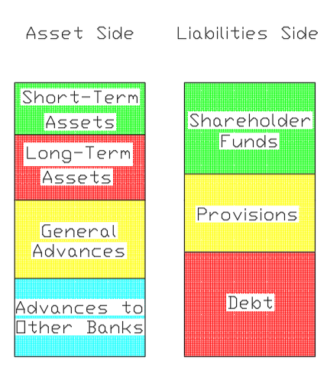
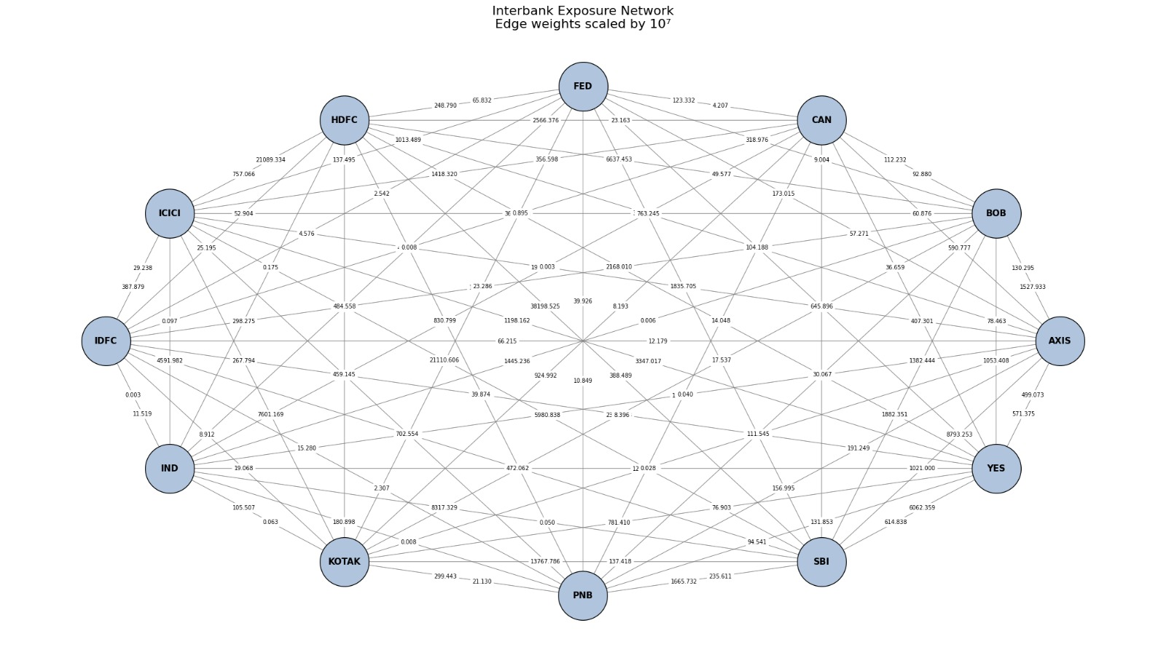
Balance-Sheet Based Network Analysis
Of the Indian Banking System
K.Varunkumar (BE23B016) Sidharth Balaji Sridharan (BS23B008)
Course Instructor:
Professor Karthik Raman

Slide 2
Objectives (Slide 1)
Banking systems are messy, complex networks that involve several institutions operating at different volumetric and temporal scales. Due to the inherent complexity of this system, it is challenging to predict when failures will occur with confidence.
To reduce the problem to a more manageable scale, economic theory suggests that banking system failures and the resulting cascades are largely driven by interbank exposures; accordingly, this interbank exposure network forms the fundamental basis for all of our analysis.
The main objectives of this project are as follows:
To analyze the Indian banking system using an improved version of the balance sheet-based network model proposed by Jorge A. Chan-Lau.
To validate our proposed mechanism for financial shocks by examining the 2018 Punjab National Bank crisis, and 2020 YES Bank crisis.
Figure 1: Interbank Exposure Network
Jorge A Chan-Lau, Balance Sheet Network Analysis of Too-Connected-to-Fail Risk in Global and Domestic Banking Systems, IMF Working Paper, 2010.

Slide 3
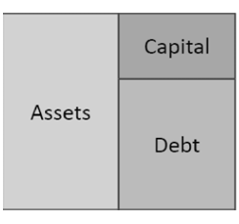
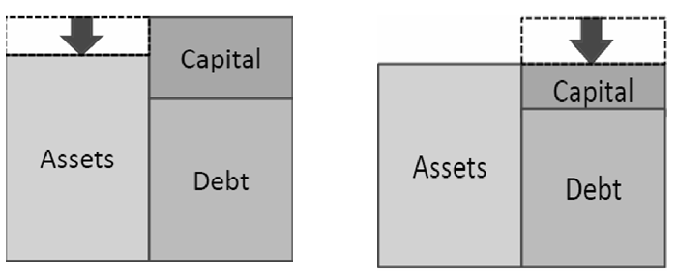
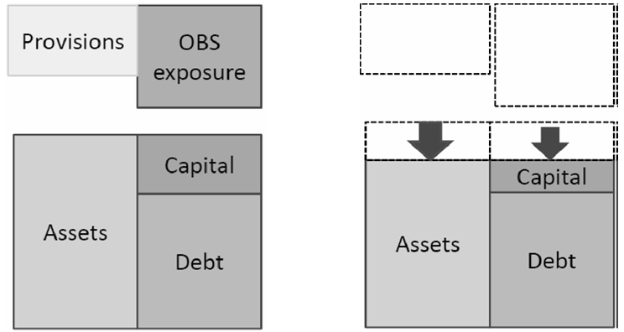
Existing Literature/Model (Slide 2)
The balance sheet–based network model proposed by Jorge A. Chan-Lau adopts a simplified and broadly applicable framework, utilizing aggregated balance sheet classes and basic shock propagation rules, as illustrated in Figures 2-4.
Advantages of this approach:
Balance sheets can be readily decomposed into these classes, making the method universally applicable across banking systems.
The results are easily interpretable and indicates which banks are most likely to fail in the system.
Figure 3: Credit Shock
Figure 2: Bank Structure
Drawbacks of this approach:
The broad scope of the model oversimplifies the classification of both assets and liabilities. Nuances in how these different classes are dealt with are lost.
The assumption of uniform exposure distribution simplifies the model and broadens its scope, but significantly reduces its accuracy and reliability.
Figure 4: Risk Transfer Shock
Jorge A Chan-Lau, Balance Sheet Network Analysis of Too-Connected-to-Fail Risk in Global and Domestic Banking Systems, IMF Working Paper, 2010.

Slide 4
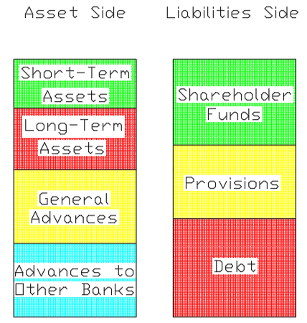
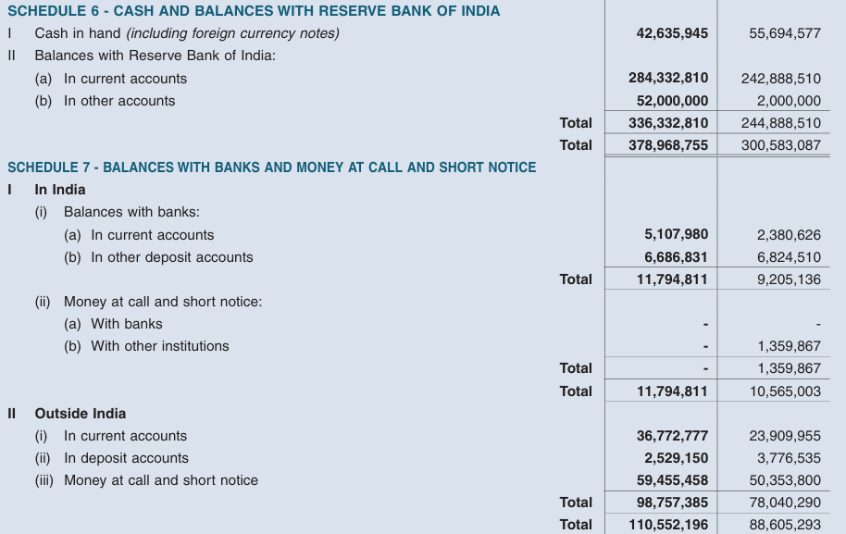
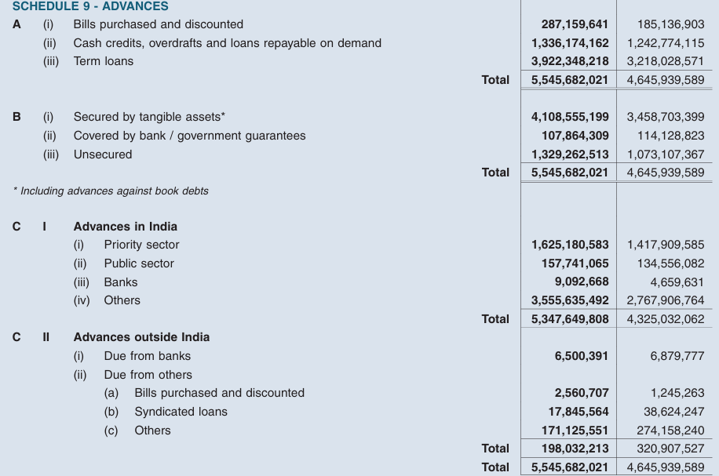
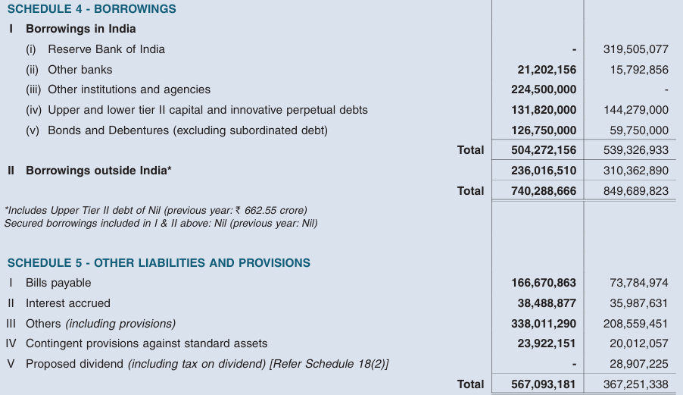
Methodology (Slide 3)
Since the scope of our model is limited to banks within the Indian banking system, we exploit the fact that these banks have a standardized balance sheet format. We adopt a more realistic structural representation of banks as shown in Figure 5.
Short-term assets are constructed using data from Schedules 6 and 7, while long-term assets are derived from Schedules 8, 10, and 11. General advances and advances to other banks are obtained from the sections illustrated in Figure 8.
A similar procedure is followed for the liability side of the balance sheet.
Figure 7: Short-Term Assets
Figure 5: Proposed Bank Structure
Figure 6: Standard Provisions
Figure 8: Advances to Other Banks

Slide 5
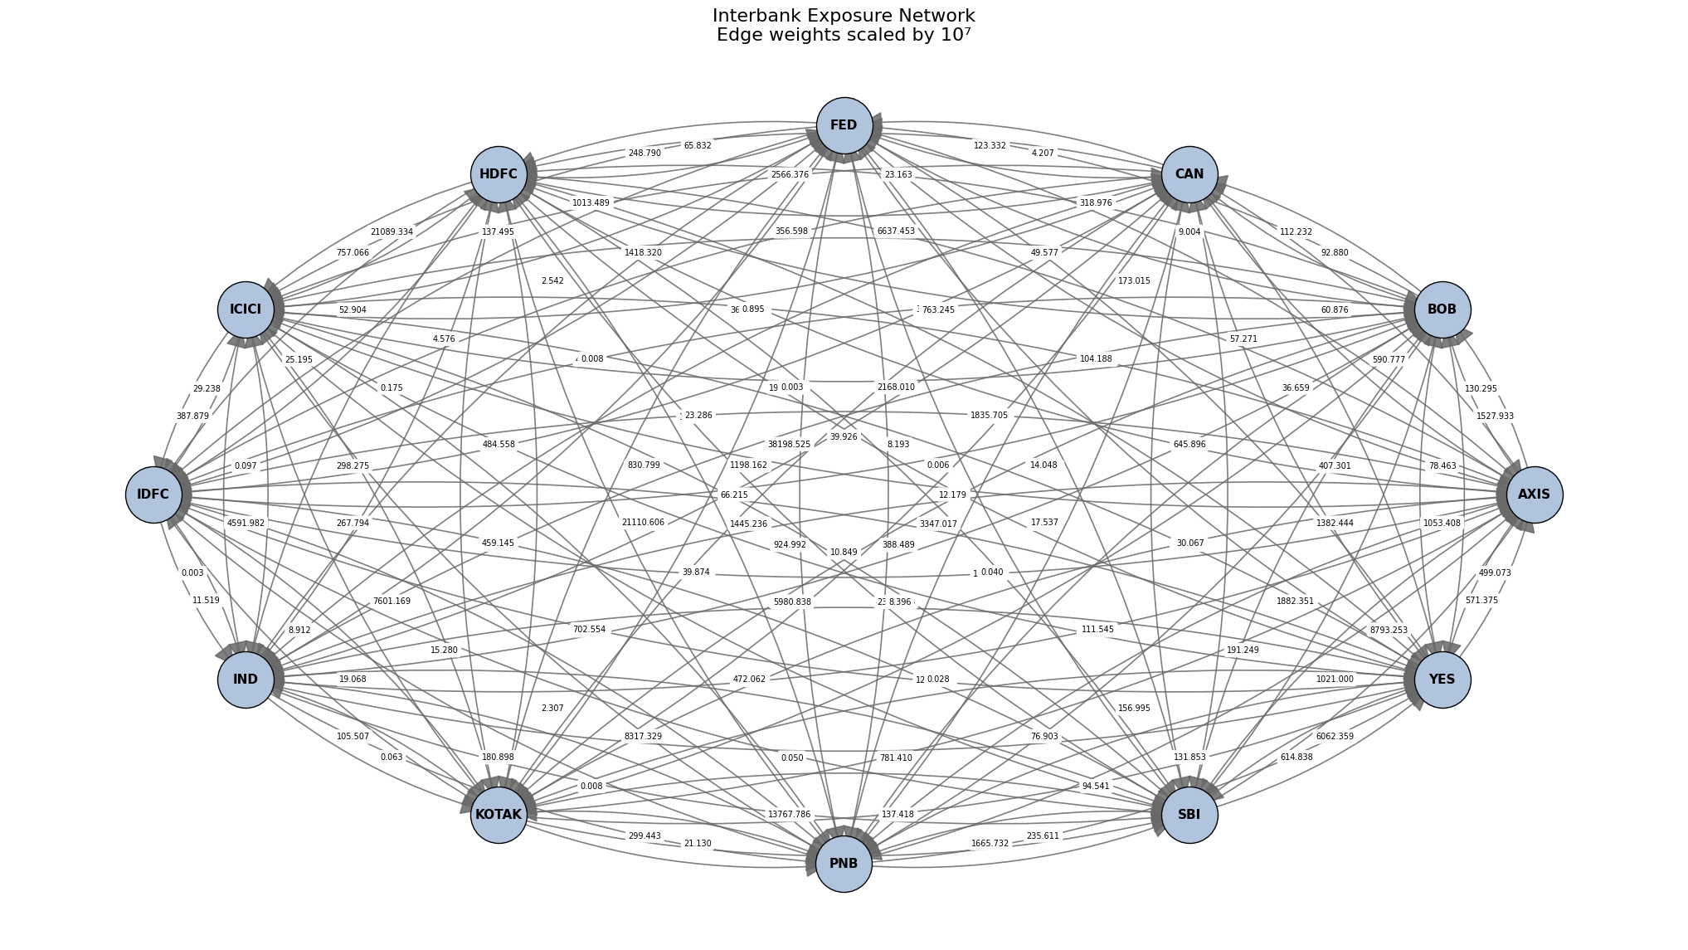
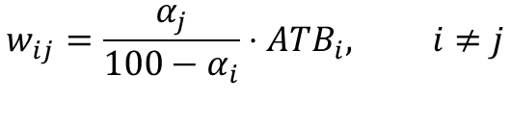

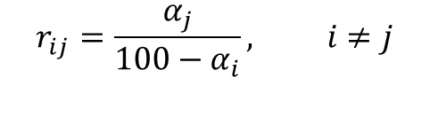
Methodology (Slide 4)
The Indian banking network is modeled as a directed network (as shown in Figure 9). Here the nodes represent banks and weighted edges represent interbank exposures.
To estimate interbank exposures, the Advances to Other Banks component is distributed across all other banks in the network using their respective BANKNIFTY index weights.
The algorithm used is shown below:
i)
$$r_{ij}=\frac{α_{j}}{100−α_{i}}, i≠j$$
ii)
$$r_{ii}=0$$
iii)
$$w_{ij}=\frac{α_{j}}{100−α_{i}}⋅ATB_{i}, i≠j$$
Figure 9: Interbank Exposure Network (FY 2017)

Slide 6
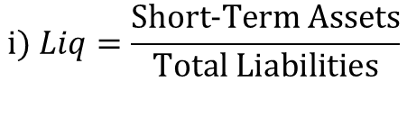
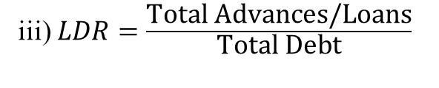
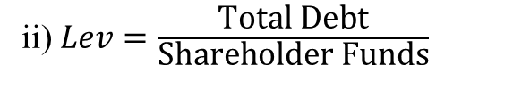
Methodology (Slide 5)
We define the financial ratios given below (which are inspired from actual financial ratios) to serve as stand-in metrics to guide post-shock adjustments and assess the financial health of banks within the system.
i) The Liquidity Ratio is defined as the ratio of Short-Term Assets (STA) to Total Liabilities (L)
$$i) Liq=\frac{\text{Short}\text{-}\text{Term} \text{Assets}}{\text{Total} \text{Liabilities}}$$
ii) The Leverage Ratio is defined as the ratio of Total Debt (D) to Shareholder Funds (SHF)
ii) $Lev=\frac{\text{Total} \text{Debt}}{\text{Shareholder} \text{Funds}}$
iii) The Loan to Debt Ratio is defined as the ratio of Total Loans (GA + ATB) to Total Debt (D)
iii) $LDR=\frac{\text{Total} \text{Advances}\text{/}\text{Loans}}{\text{Total} \text{Debt}}$
Of the three ratios, the Liquidity Ratio (Liq) and Leverage Ratio (Lev) are used to restore balance between the asset and liability side following a perturbation, while the Loan to Debt Ratio (LDR) alongside Advances to Other Banks and Long-Term Assets are used as penalty measures to assess the state of a bank in the network.

Slide 7
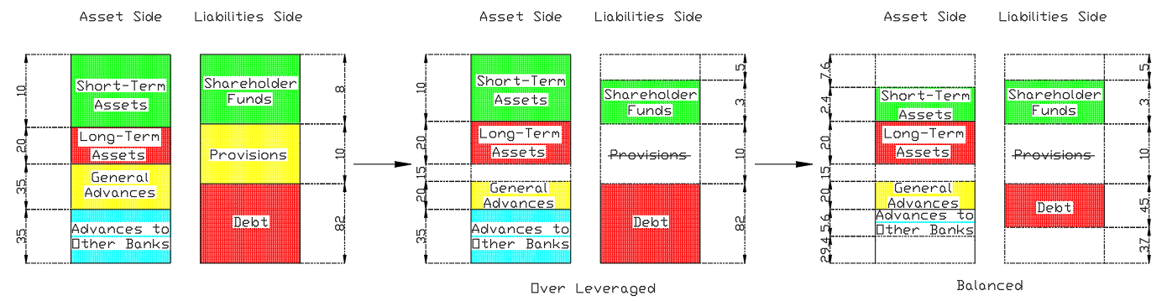
Methodology (Slide 6)
Risk Transfer Shocks are used to simulate the collapse of an initial bank due to risky lending practices.
General Advances is reduced by a specific shock fraction.
The resulting loss is first absorbed using standard provisions maintained for non-performing assets.
Any remaining loss is absorbed by shareholder funds, which might result in the bank becoming over-leveraged.
If over-leveraged, the bank deleverages (by reducing excess debt) to meet the maximum allowable leverage limit.
To restore balance between the asset and liability sides of the balance sheet, short-term assets are liquidated (while maintaining minimum liquidity), with any remaining adjustment met by making callbacks to other banks.
Figure 10: Risk Transfer Shock

Slide 8
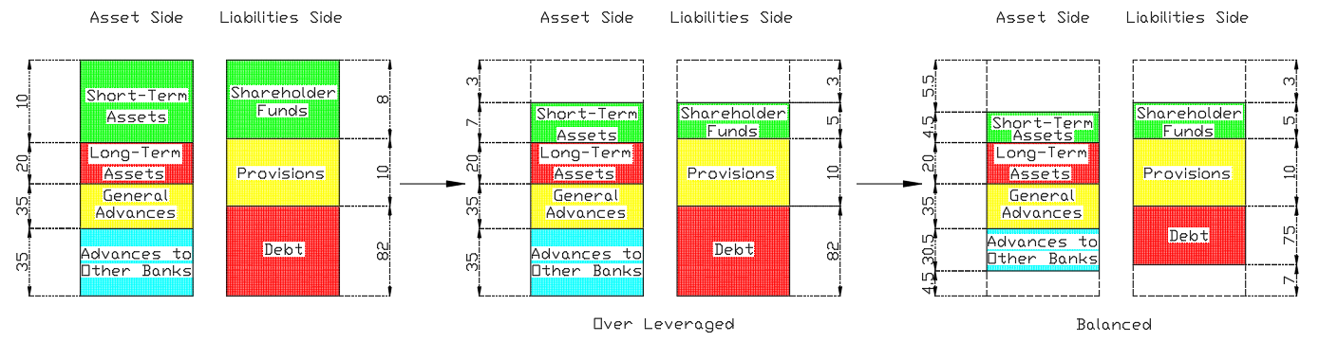
Methodology (Slide 7)
Credit Shocks are used to simulate global decline in the value of short-term assets (arises due to global market failures).
Short-term assets are reduced by a specific shock fraction for all banks in the network.
Resulting losses are absorbed by shareholder funds, which might result in the bank becoming over-leveraged.
If over-leveraged, the bank deleverages (by reducing excess debt) to meet the maximum allowable leverage limit.
To restore balance between the asset and liability sides of the balance sheet, short-term assets are liquidated (while maintaining minimum liquidity), with any remaining adjustment met by making callbacks to other banks.
Figure 11: Credit Shock

Slide 9
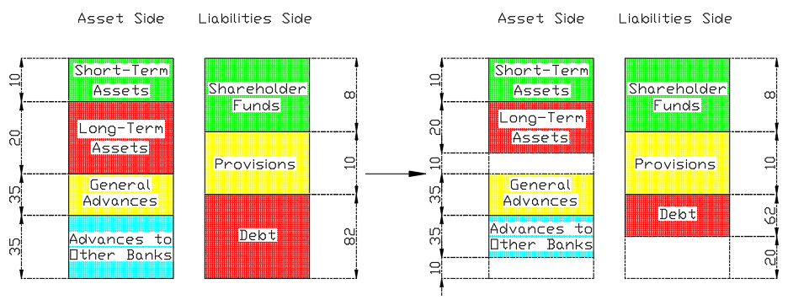
Methodology (Slide 8)
Funding shocks are used to propagate the initial stress/shocks across the interbank network. When Bank A calls back the advances it has made to Bank B, Bank B is said to be experiencing a funding shock.
A reduction in debt equal to the total value of callbacks experienced by the bank begins the process.
Affected banks restore balance by liquidating long-term assets and recalling interbank advances (in a 50/50 split).
Realizable value of long-term assets depends on bank state (100% when healthy and 75% when in crisis.).
Resulting losses are absorbed by shareholder funds (potentially causing the bank to be over-leveraged); this is then corrected through deleveraging and making callbacks to other banks, as described previously.
Figure 12: Funding Shock

Slide 10
Results and Discussion (Slide 9)
Predicted Default Banks: Punjab National Bank, Canara Bank, Bank of Baroda, Axis Bank, State Bank of India, Federal Bank.
Predicted Banks in Crisis: ICICI Bank, Kotak Mahindra Bank, IDFC Bank, YES Bank.
Official reports and newspaper articles indicate that the banks affected by the scam included Punjab National Bank, Canara Bank, Axis Bank, and State Bank of India.
Figure 13: Simulating the PNB Scam using our model
The model accurately identifies several affected banks; however, it appears to overestimate the severity of impact for some institutions, and seems to be making a couple of erroneous predictions.
NOTE: Allahabad Bank and Union Bank of India were also impacted, but are excluded from the scope of this model.
Times of India, PNB fraud affects these banks too, Feb 17, 2018

Slide 11
Results and Discussion (Slide 10)
Predicted Default Banks: Punjab National Bank, Bank of Baroda, Axis Bank, State Bank of India, IDFC Bank, YES Bank.
Predicted Banks in Crisis: ICICI Bank, IndusInd Bank, Kotak Mahindra Bank, Federal Bank.
In 2020 both the YES Bank crisis (Risk Transfer shock) and the COVID-19 pandemic (Credit shock) took place. Consequently, most reports are unable to clearly attribute banking system failures to a single trigger.
Figure 14: Simulating the YES Bank Scam using our model
From this, it is evident that PNB, SBI, Central Bank of India, Bank of Baroda, and Canara Bank were the public sector banks most significantly affected, while Axis Bank and IDBI Bank were among the impacted private sector banks; however, the extent of damage remains uncertain (different sources cite different figures).
Financial Express, PNB, SBI among worst hit PSU-banks by bad loans to top 50 wilful defaulters, March 16, 2020

Slide 12
Conclusion (Slide 11)
As shown in Slides 9 and 10, the model is able to largely predict which banks are likely to fail, and its outcomes align reasonably well with observed reality. This suggests that a system-specific, balance sheet-based network analysis, incorporating realistic bank structures and rules, provides more meaningful insights than a generic or simplified balance sheet-based model.
However, the model has notable limitations. It tends to produce erroneous predictions for smaller banks such as Federal Bank and Bank of Baroda, primarily due to the disproportionate ratio between their BANKNIFTY index weights and their total asset or liability values. As a result, exposures to affected banks may be overestimated, leading to inaccuracies in predictions.
In events such as the PNB scam of 2018, banks outside the scope of the model, including Allahabad Bank and Union Bank of India, were also impacted. These secondary effects are not captured within the current framework.
Accordingly, the results should be interpreted with these limitations in mind. The model’s blind spots can be addressed by using its results in conjunction with the model created by Jorge A Chan-Lau to obtain more accurate and realistic insights.
THANK YOU!

